Slide 1
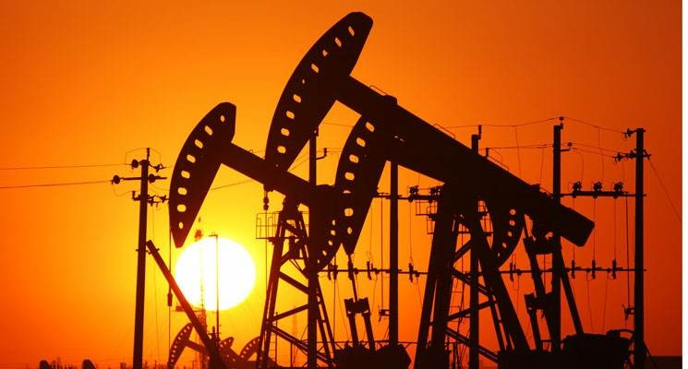

The “Heritage” of The Fossil

Slide 2



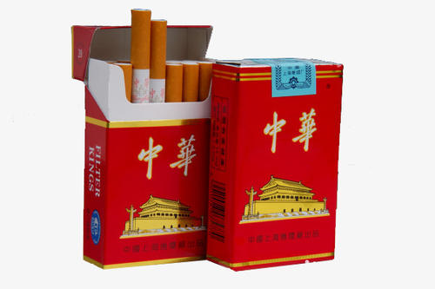
Energy Consumption and Waste
&

Slide 3
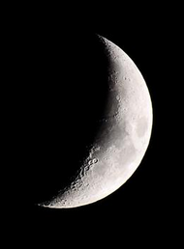
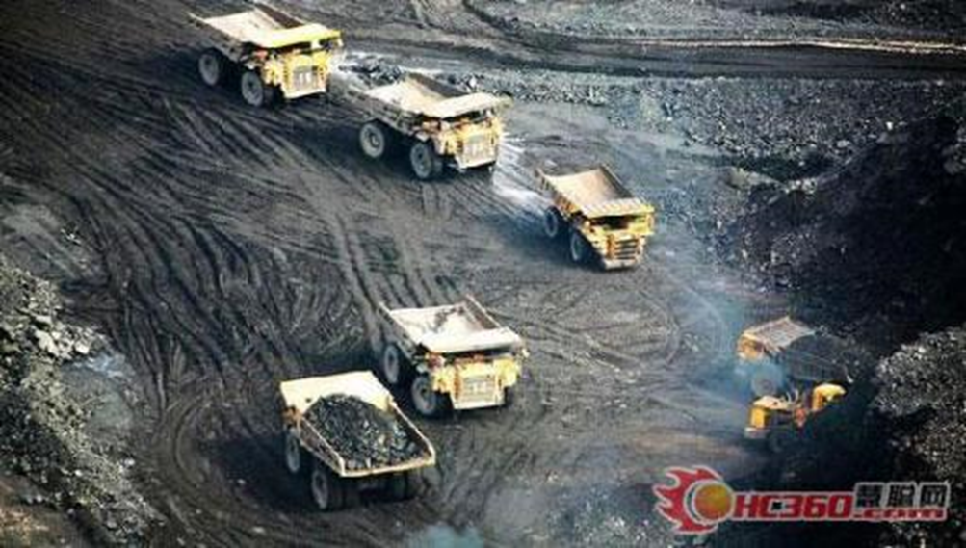
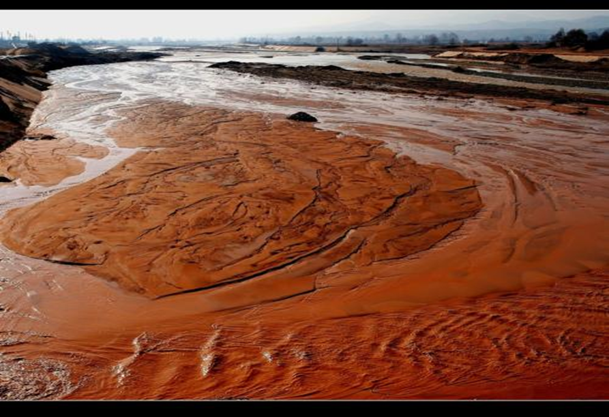
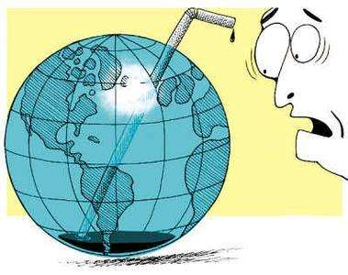
Dark Side of Fossil Energy
From Baidu
From Baidu

Slide 4
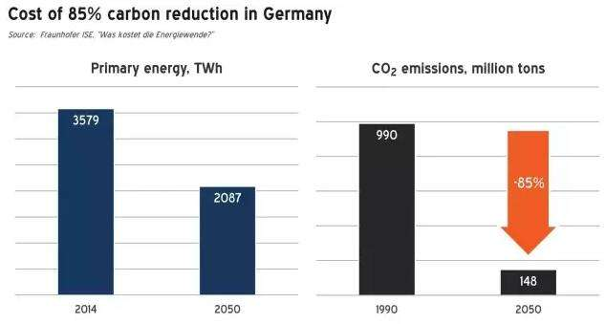
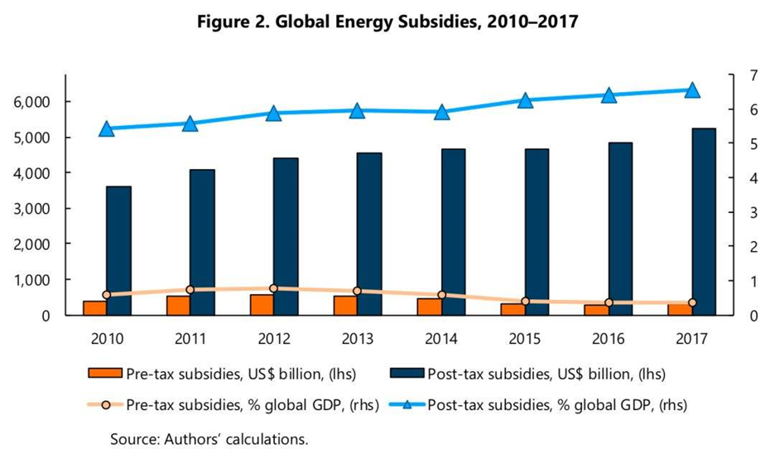

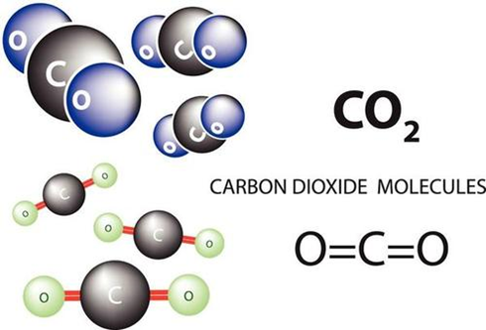
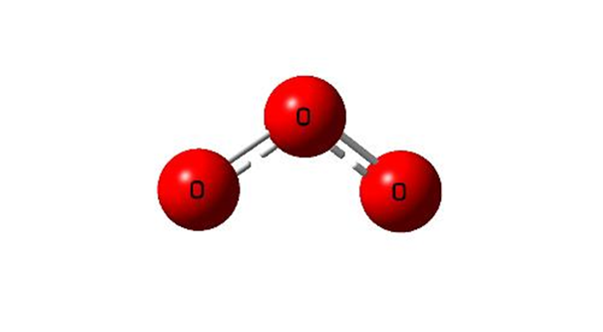
Obvious Contrast and Reflection
From Zhihu
emission:

Slide 5



What Shall We Do？
OR

Slide 6


Take Road of Sustainable Development
1.
From NCSE

Slide 7

2.
Objective and Appropriate Pessimism
From Baidu

Slide 8

—— END ——
Thank You!
——Mox Liu

